Slide 1



Disaster Risk Governance
Making the World a Better, Safer, Smarter & More Resilient Place to Continue Living……

Slide 2

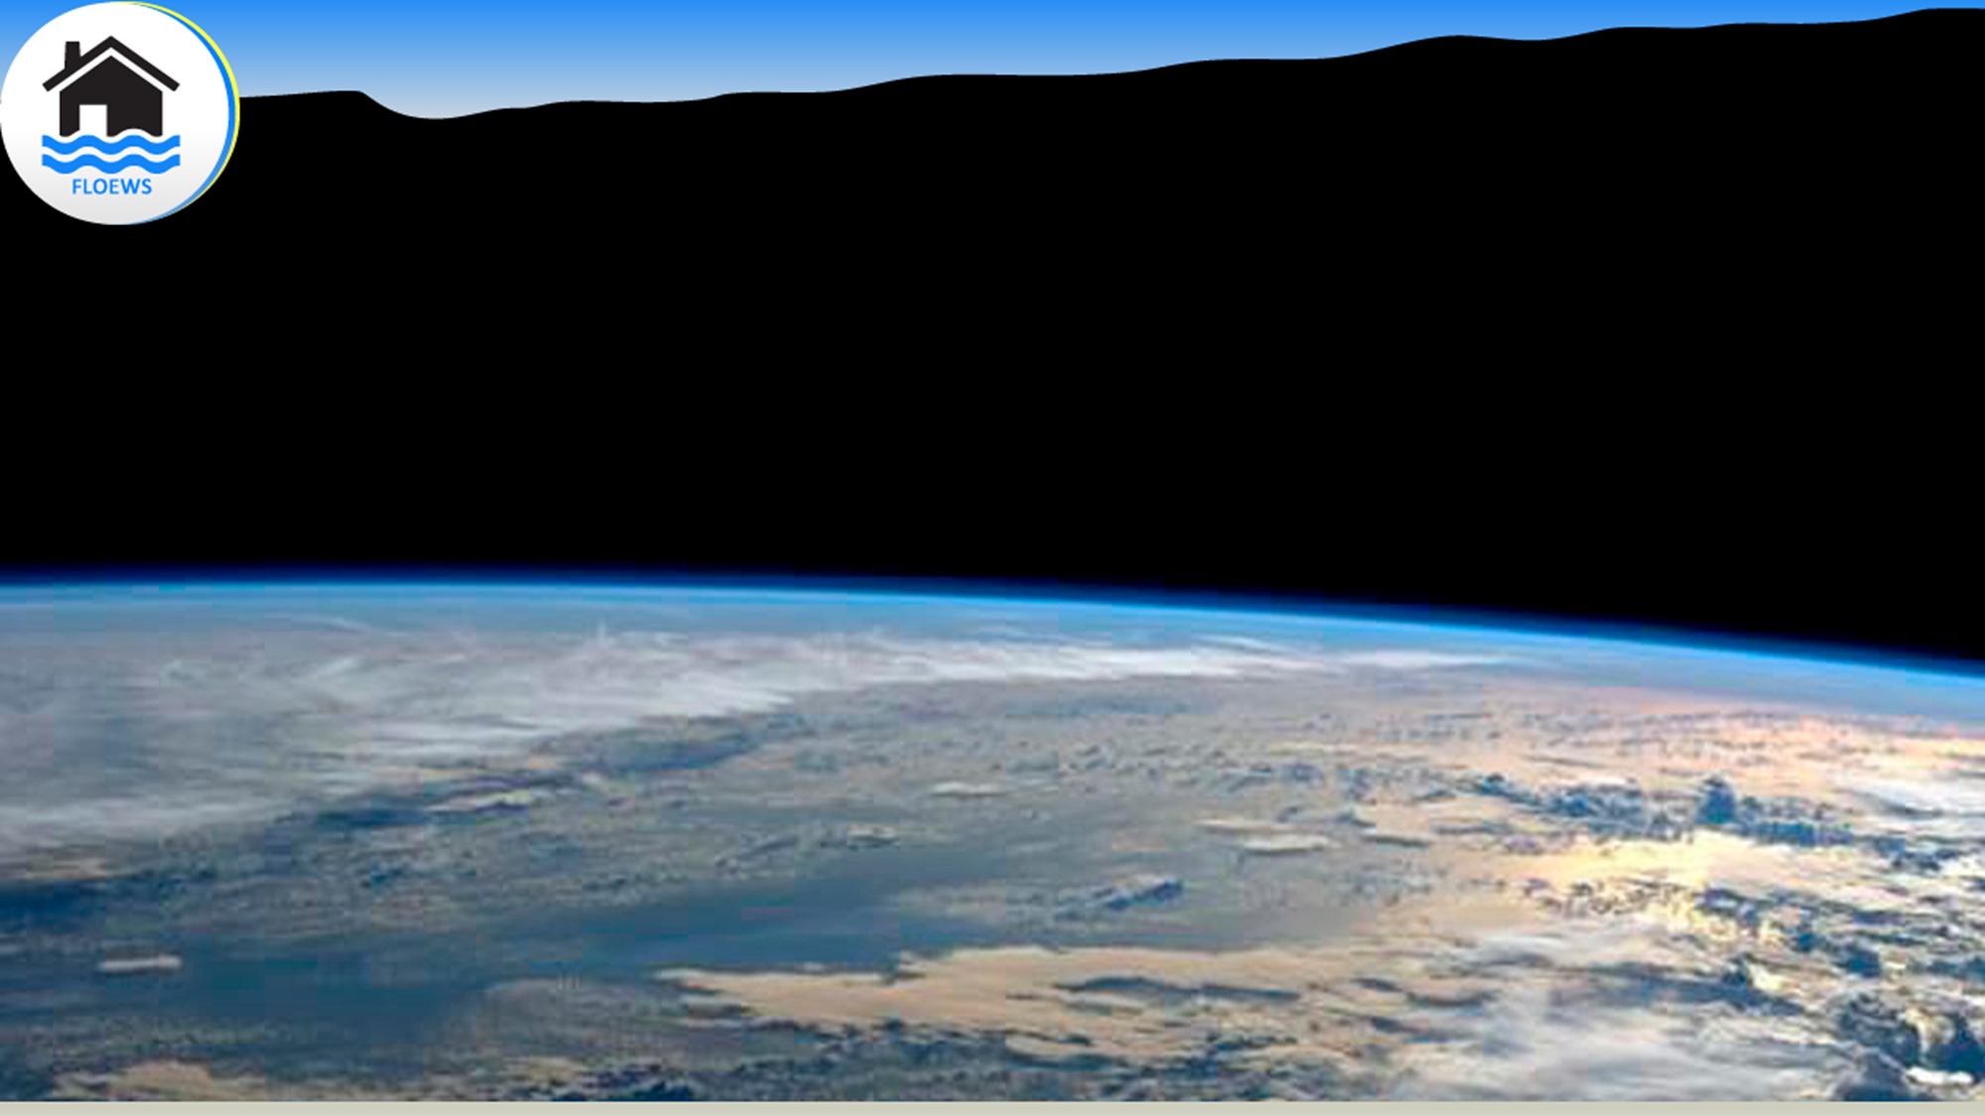
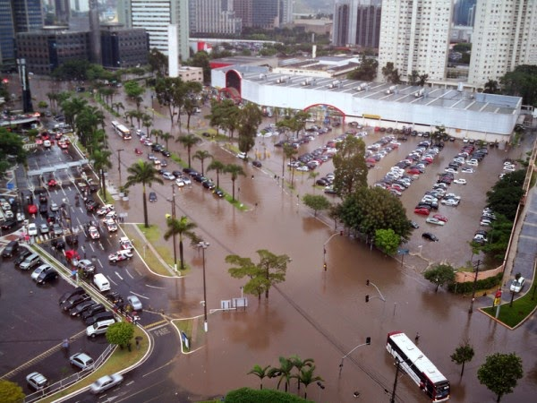
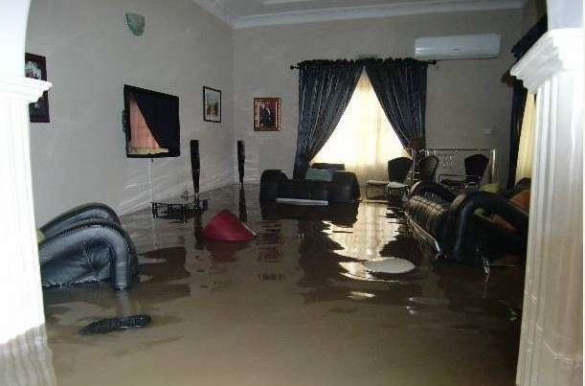
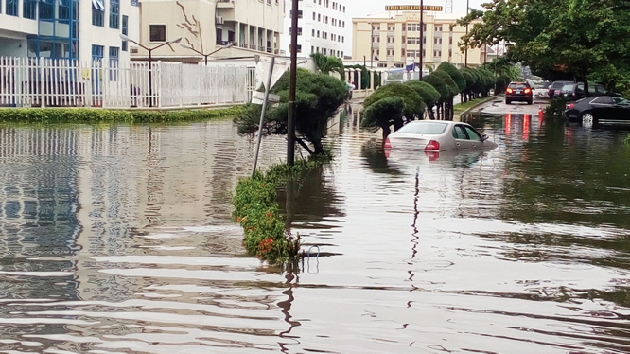
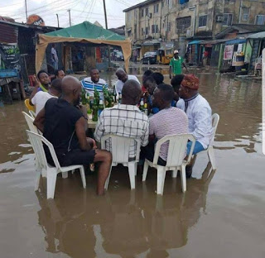
PROBLEM

Slide 3
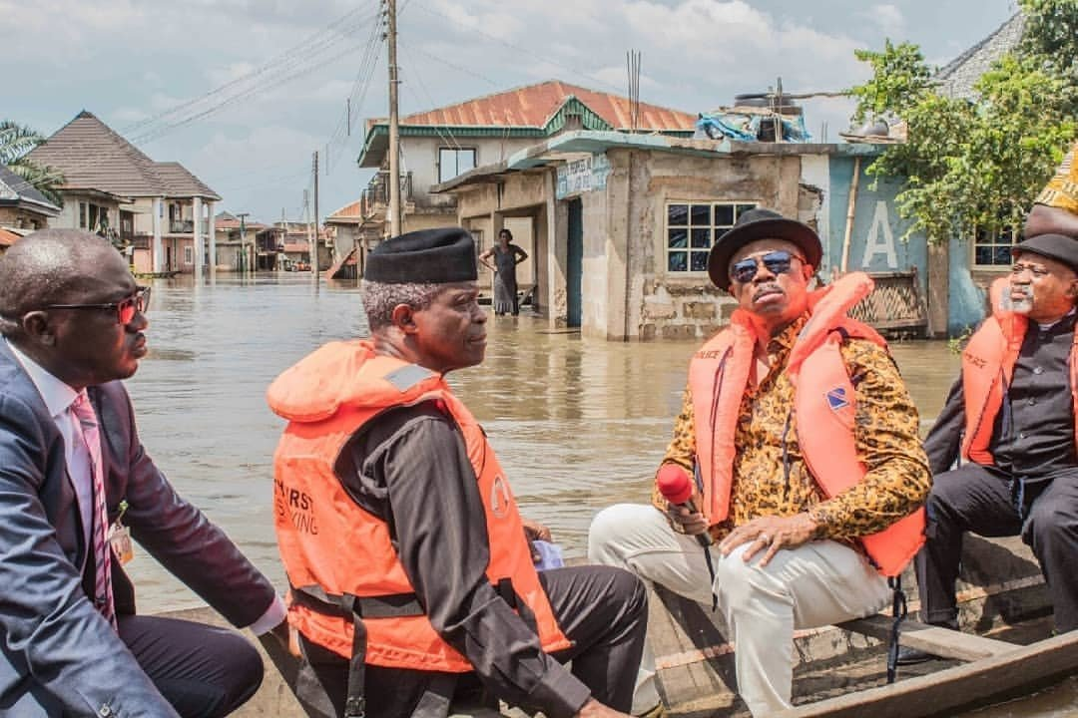

Impact of the Problem
Natural Disaster Menace (Flood)
Accounts for about 71% of all deaths related to natural disasters.
45% occurrence frequency.
$119Billion economic losses alone in 2019.
70% of the 3rd World Country face climate injustice,
Source: GFDRR 2019

Slide 4

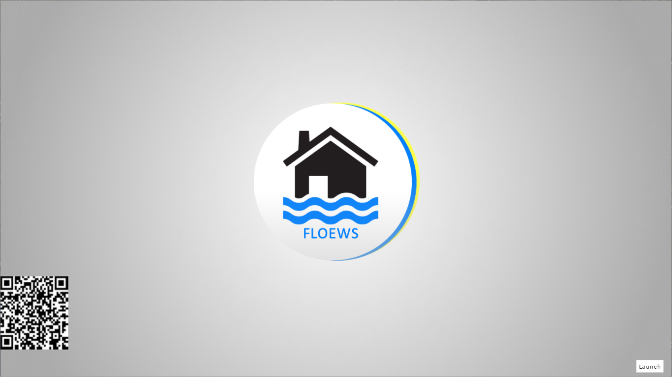

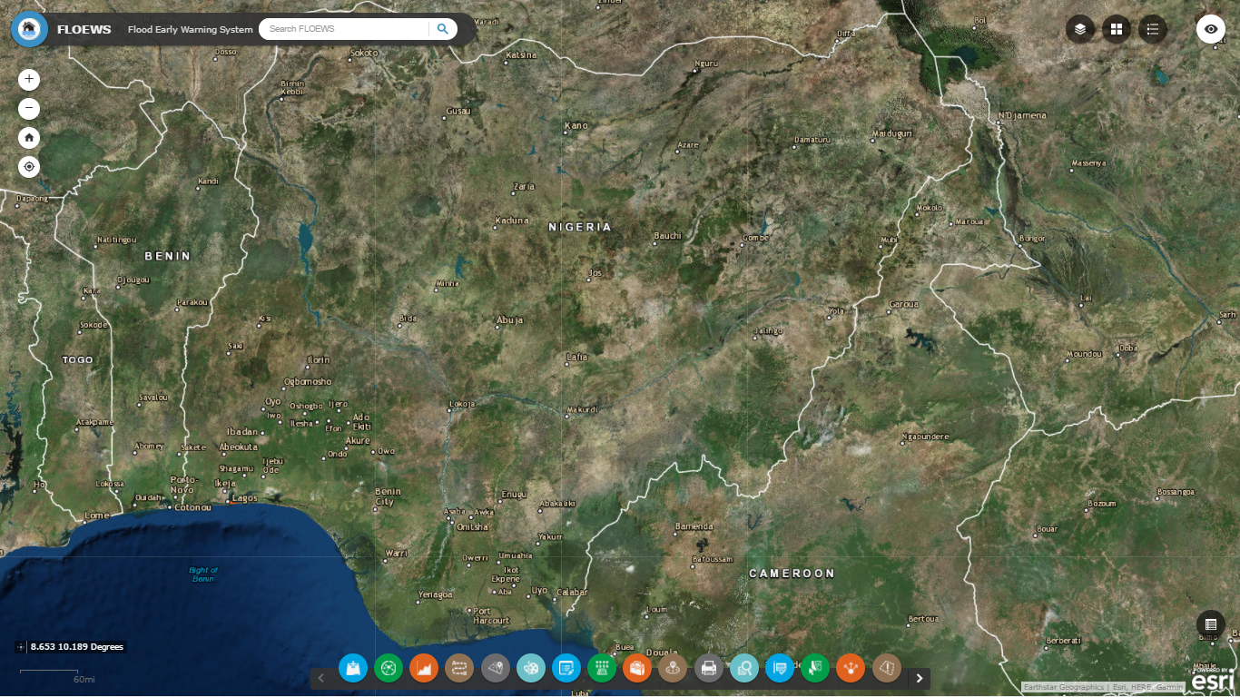
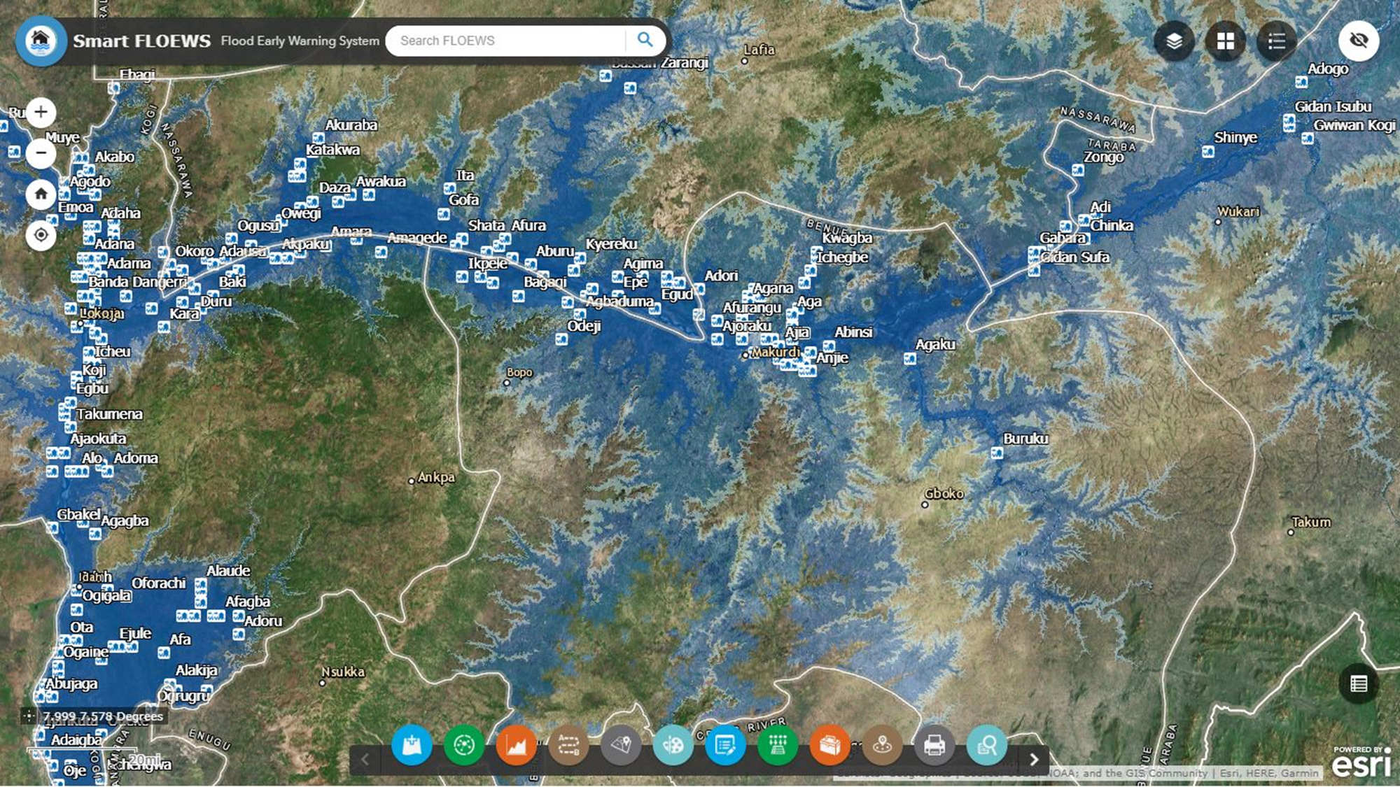

Slide 5
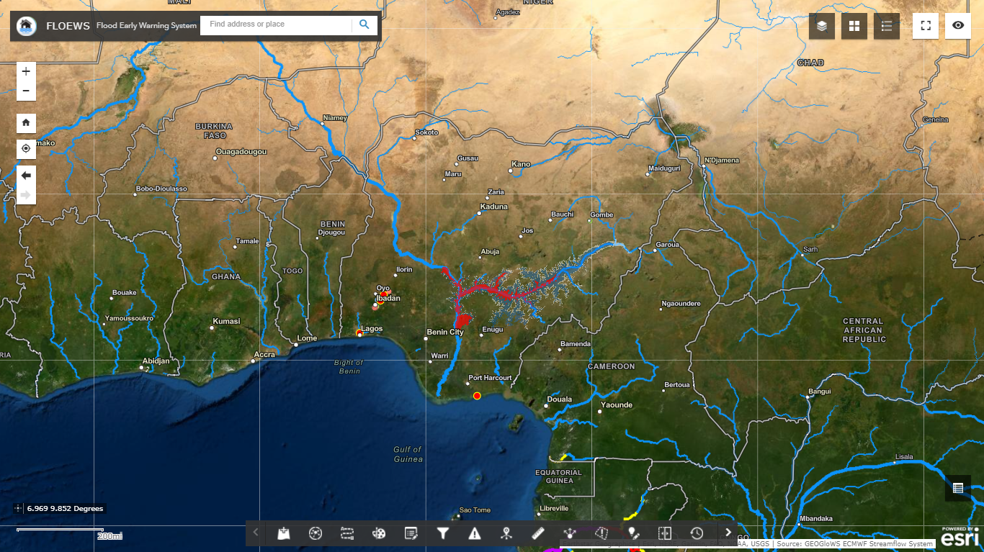

Slide 6


Slide 7
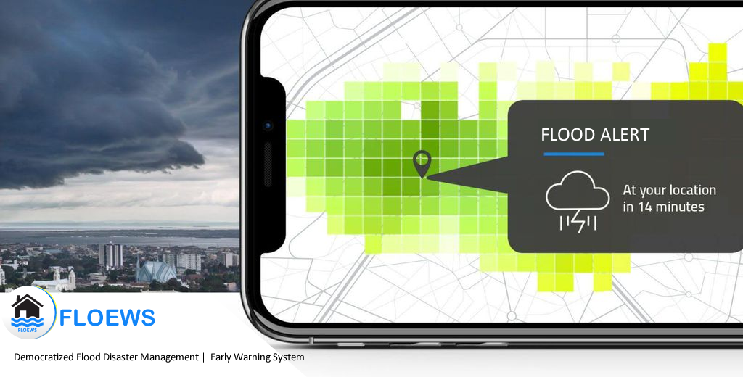

Slide 8
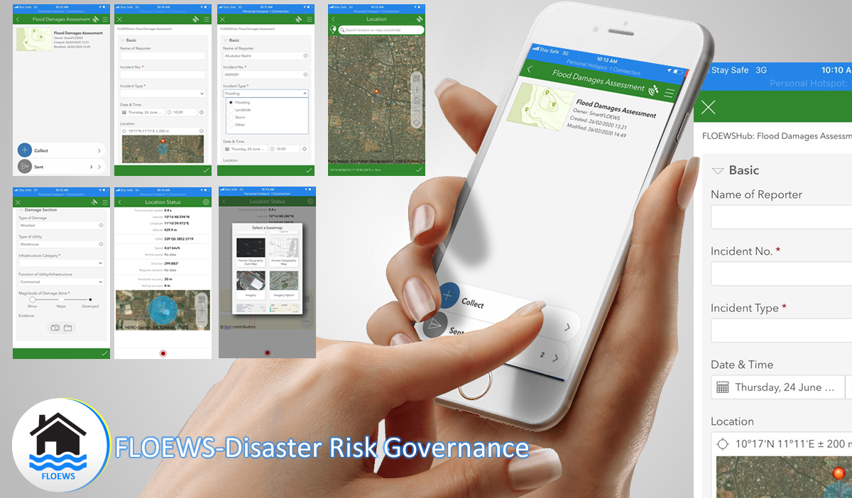
Flood Disaster Reporting through Citizens Engagement

Slide 9
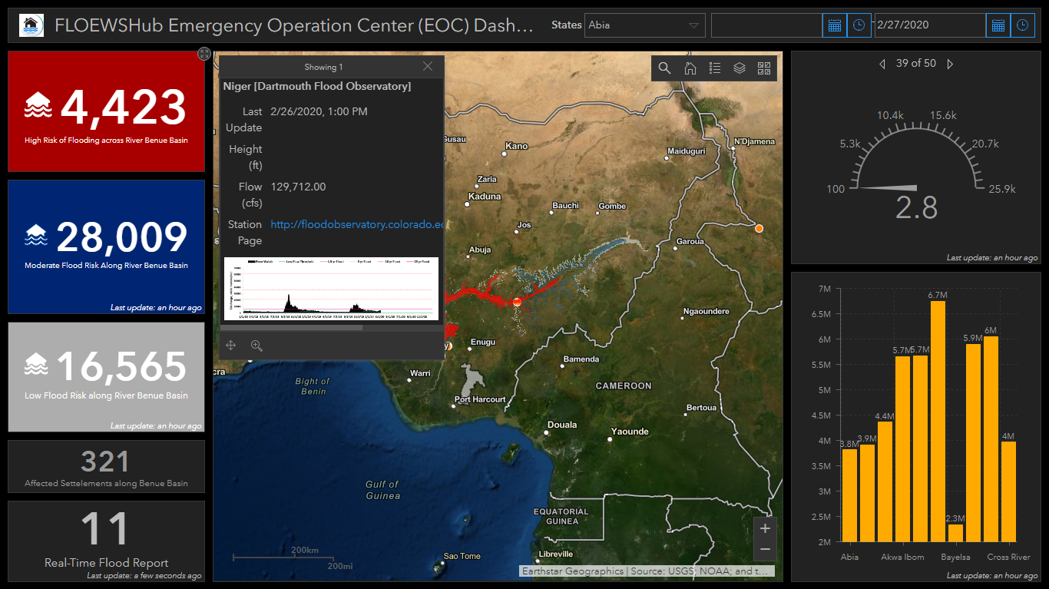

Slide 10
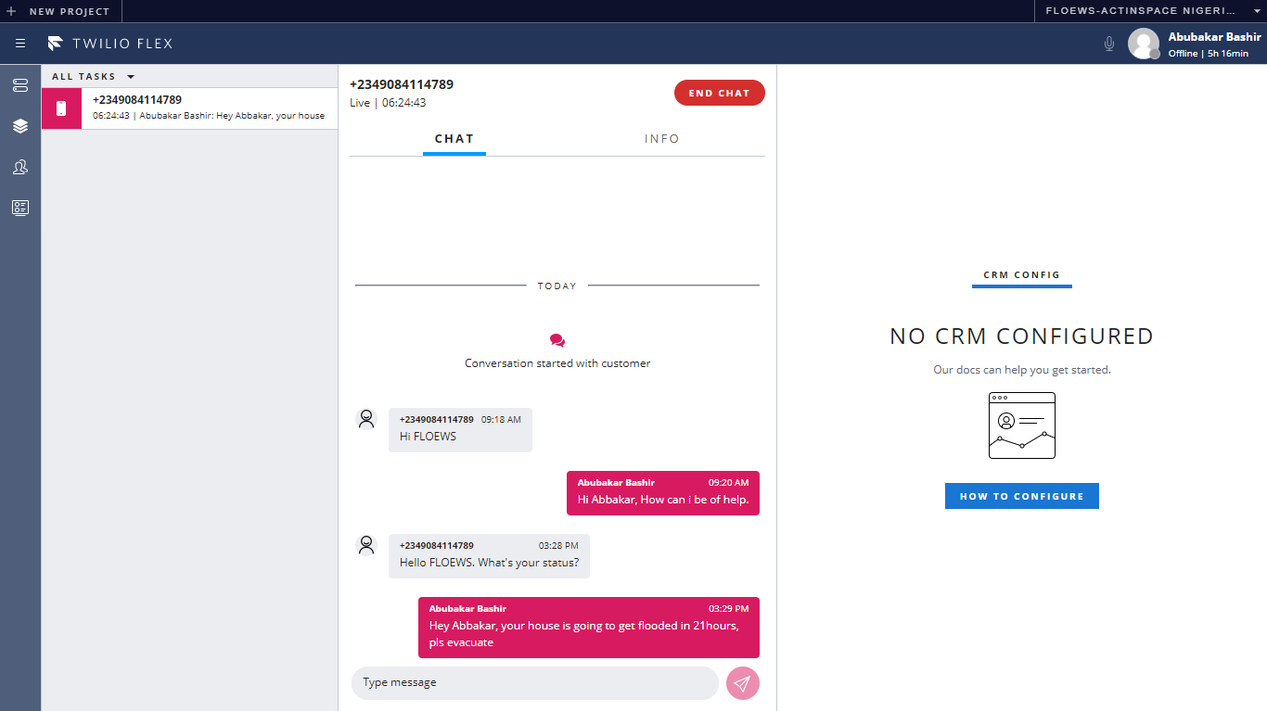
FLOEWS-Disaster Risk Governance

Slide 11
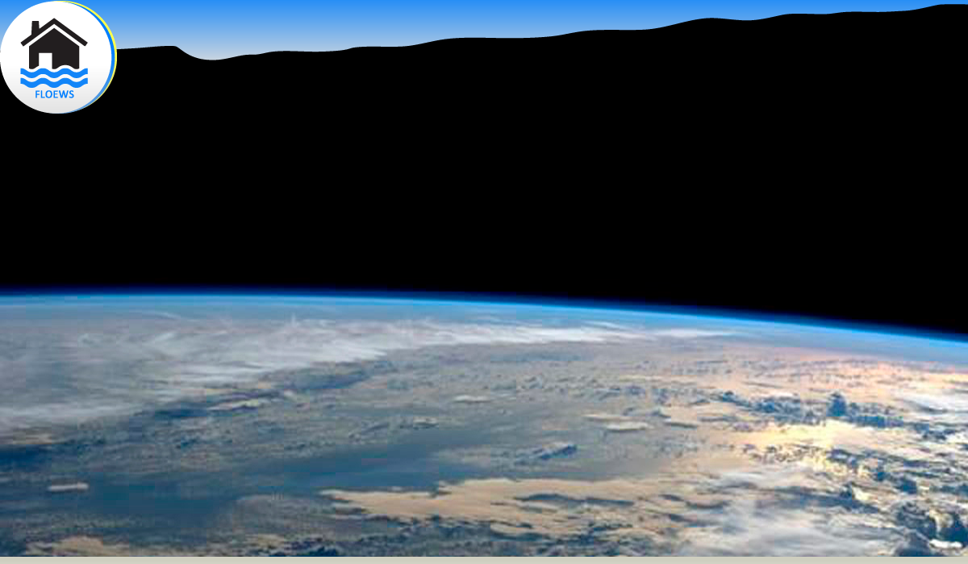
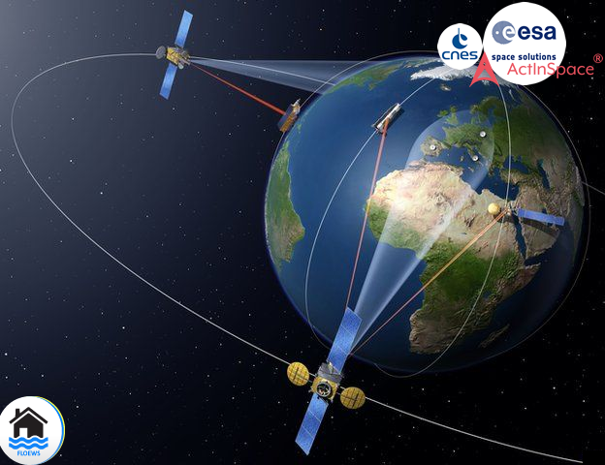
Data Sources & Types
Meteorological data
Topographical data
Demographic
data
Hydrological data
Biospheric
data
Bring your own data
EO Data:
Synthetic Aperture Radar (SAR).
Advance Synthetic Aperture Radar (ASAR)
SAR
MODIS.
DSM/DTM.
NDVI.
SDVI.
ASTER.
Aerial Imageries (High Resolution) etc.
Insitu Data:
Hydrological & Hydraulic data.
LIDAR etc.
Secondary Data Providers:
CNES
ESA
NASA
Airbus
GRID3.
NBS.
Planet.
Direct Relief

Slide 12
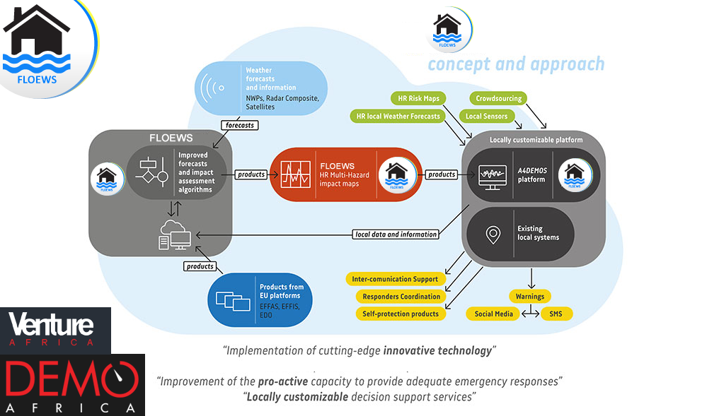


Slide 13
Multi-Channel Dissemination
FLOEWS-On-Premises.
Cloud-based FLOEWS-AS-A-Service.
Open/Access data Services.
API.
Web/Mobile applications.
Social Media.
SMS/USSD/IVR/Chatbot.
Print media.
Peer-to-Peer.
IoT Based Mesh Network.
Cell Tower Broadcast
By Geography

Slide 14
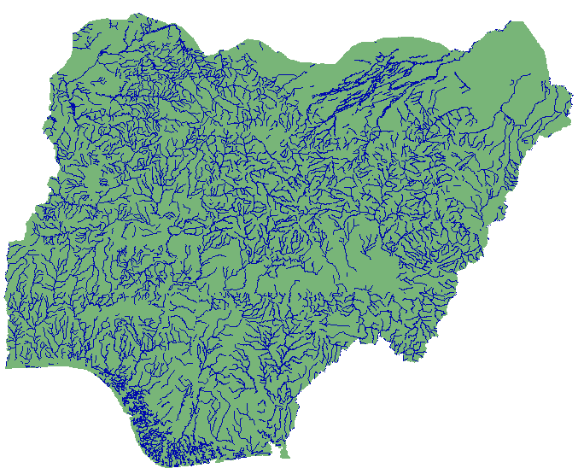
Research & Academia
Government
Millennials
Enterprise
Customers Segment/Beneficiaries
Governmental Ministries & Agencies: LGA, NEMA, SEMA, Ministry of Environment, Water Resources, Agriculture, Inland waterways, UBRBDA, NIHSA.
NGO & Humanitarian Organizations: World Bank, UN, UNOOSA, UN-SPIDER, GFDRR, UNISDR, WHO, UNOCHOA, UNDP, Direct Relief etc.
Enterprises/Business: Oil & Gas industry, Telco’s, Insurance Insurers, Urban & Regional Planners, Real Estate & Estate Developers, logistic & Supply Chain managers, Risk & assets assessor & analyst, Engineering & construction, Surveying & Geo-Informatics, large-scale commercial farmers etc.
Research & Academia Education.
Software Developers and ICT industry.
Millennials & Digital Age.
Last Mile Users: Subsistence farmers, low class urban, rural farmstead, isolated hamlet inhabitants, the marginalized such as: women, children, disabled & aged.

Slide 15
MARKET
Business & Revenue Model
Subscription Model.
Freemium Model.
Incentive Model.
Donation & Sponsored Model.
Consultancy/Contract
Direct Sales Model.
All on the basis of B2C, B2B, B2G
TARGET ADDRESSABLE MARKET (TAM)
1.9 Billion Vulnerable People Globally
MARKET COMPETITORS
SERVICEABLE ADDRESSABLE MARKET (SAM)
121 Million Nigerians
Non of any companies nor startups local or
globally are solving the same problem and
providing similar solution as FLOEWS.
The competitors Involves:
Deltares in the Netherlands
Ambiental in the UK.
Floodlist in the UK etc.
SERVICEABLE OBJECTABLE MARKET (SAM)
17 Million

Slide 16
UNIQUE SELLING POINT (USP)
FLOEWS is Dematerialized, Demonetized & Democratized.
FLOEWS posses a socially inclusive access.
Multi-Channeled.
Its tap a its data-source from a Unique & Untapped Data Source from wireless signal thereby creating a Hyper-Local weather intelligence.
Hyper-Spectral Accuracy.
Can be replicable across geographies.
Can be Tailored.
Work with or without internet (Mesh Network).
Socially inclusive.
Affordable & Even Free.
TARGET ADDRESSABLE MARKET (TAM)
5.4 Billion

Slide 17
Impact of Solution
FLOEWS-Disaster Risk Governance will be reducing overall devastation caused by flooding disaster among lives; especially the marginalized, under-served and climate unjust individuals, communities and economies etc, valuable properties, utility/Infrastructure, bio-diversity, food/water supply & economic losses estimated in $billion.
Overall, the solution intends to;
Reduce flood disaster-based mortality by 25% by 2030.
Reduce overall disaster exposure by 31% by 2030.
Save more lives.
Make victims flood resilient.
Cover about 150,000sqkm of critical vulnerable corridors across Nigeria and neighbouring countries.
Make FLOEWS-Disaster Risk Governance services accessible to everyone across our multi-channel gateways by 2030.
Make the Nigeria and World in a whole a safer, smarter and more resilient to continue living against the adversity of flooding disaster.
TARGET ADDRESSABLE MARKET (TAM)
5.4 Billion

Slide 18
Future Plans
If lucky, we will use the money won from the competition and also bootstrap from our pocket and build an advance MVP version of the solution, up to the stage were by we can attract the minds of angel investors or early stage start-up VC's for a pre-seed investment.
Beta Launch, then after a successful feedback to early users and adaptors, then we further plan to launch the full Alpha version ready for both large scale and commercial usage.
Market Penetration & Survival.
Growing customers based first 1,000 by the end of 2021.
Cover more flood Vulnerable Area; 150,000+ sqkm by 2025.
Obtained 100,000+ paying customers by 2035.
Reach 5,000,000+ Beneficiaries by 2030 across the world.
Raised $5 Million by 2025 across both Grant, Donation & Equity funding (Seed).
Validate all our proposed solution channels of dissemination.
Expand to other markets and geographies.

Slide 19
ASK
$200,000 Pre-Seed Investment for 6% Equity of our new solution based startup, so as to launch fully, further our R&D, Operations & Market Expansion.
Partnership:, NASRDA, NIHSA, VC, Research Institution, AWS, Azure, google.org, X-Prize & MIT Solve.
Interns & season volunteers.

Slide 20

Abubakar Bashir
(Team Lead)
Adam Abba Abubakar
(Lead Data Engineer)
Nusaiba Adamu Misa
(Business Intelligence)
Ibrahim Abubakar Kuchili
(Situational Awareness
& Incident Manager)

Slide 21
Conclusion
For Every $1 invested in preparedness will save about $12 in Recovery
Thanks

